Slide 1

Consortium Meeting Small RNA-seq Update
June 5th, 2017
Carrie Wright

Slide 2
Sources of Variability and Bias in small RNA sequencing
Starting Amount
sRNA Purification
Adapter Ligation Bias
Amplification Bias

Slide 3
Current microRNA kits available
 | Kit | Disadvantage | Starting RNA | Price per sample | Preferential ligation bias considered? | Account for dimer bias? | Note
1 | Clontech -SmarterSeq |  | 1ng | $111.67 | Yes, Ligation independent- uses RNA 3' polyadenylation and SMART (switching mechanism at the 5' end of RNA template) which is sequence-independent | No- probably ok if you use correct starting amount | Could be pretty good for bias
2 | BIOO-NextFlex |  | 5ng + for gel prep, 200ng+ for gel free prep | $65.63 | Yes, ligation- uses randomized adapters | Yes, adapter-dimer reduction | Best correlated with qPCR over Illumina TrueSeq –suggested for bias – can do without gel
3 | seqmatic - Tailormix miRNA sample preparation kit V2 |  | 10 -100 ng total RNA input | $90 | Don’t think so | Yes, gel extraction to reduce adapter-dimers | Could be OK for bias
4 | seqmatic - Tailormix miRNA sample preparation kit gel-free |  | 150 ng total RNA input | $90 | Don’t think so | Don’t think so | No gel required
5 | NEBNEXT |  | 100ng-1ug | $61.25 | Don’t think so | Yes, adapter-dimer removal | most commonly used after Tuseq, should be OK for bias
6 | Ambion | might require more RNA or purification | 100ng if purified, less than 1 micro gram if not | ??? | Don’t think so | Don’t think so | Probably not a good option
7 | Applied Biosystems (from Ambion) SOLiD | Compatible? | 10-250ng | $61 | Yes, Altered adaptors to reduce ligation bias | No | Could be quite good for bias but may not be very compatible with sequencing
8 | Trilink-CleanTag |  | 1-1000ng | $70.63 | Don’t think so | Yes, adapters block adapter-adapter ligation to reduce dimer production | Could be OK for bias, can do without gel
9 | Illumina-TrueSeq | High starting amount | 1000ng | $100 | Maybe…Adapters are short, so this may reduce bias, no dimer reduction involved- so will get dimers if use lower than recommended starting amount | No, but should not have any if use correct starting amount | Known to be gold standard Indexing/barcoding during PCR – after ligation (not directly to miRNA reduces bias)

Slide 4
Kit | llumina | NEXTflex | NEB | Clontech
Ligation / Polyadenylation | 3' adapter ligation; adapter-dimer formation prevented by addition of Stop Solution 5’ adapter ligation | 3' adapter ligation; adapter-dimer formation prevented by excess adapter removal and inactivation 5’ adapter ligation | 3' adapter ligation; adapter-dimer formation prevented by hybridization of RT primer to excess adapter 5’ adapter ligation | 3' polyadenylation
cDNA Synthesis (RT) | Reverse transcription | Reverse transcription | Reverse transcription | Reverse transcription 3’ smRNA dT Primer adds 5’ adapter sequence to cDNA first-strand SMART template switching adds 3’ adapter
Amplification (PCR) | PCR amplification | PCR amplification | PCR amplification PCR product purification | PCR amplification and addition of full-length Illumina adapters PCR product purification
Size Selection | PAGE | PAGE or NEXTflex beads | PAGE or Pippin Prep agarose gel | AMPure XP beads or BluePippin agarose gel
Consideration | Generally accepted to be gold standard | Randomized adapters | Most commonly used for smaller input quantity | Ligation-independent

Slide 5
Kit Comparison : 2 Phases
Accuracy Test
How similarly are different miRNAs detected?
Reproducibility Test
How consistent are the results within and across batches?

Slide 6
Kit Comparison, Phase 1: Accuracy test
Accuracy Test
How similarly are different miRNAs detected?
Kit | Illumina | NEXTflex | NEB | Clontech
Synthetic miRNA | 300ng | 300ng | 300ng | 300ng
miRXplore Universal Reference (Miltenyi Biotec Inc.), an equimolar pool of 963 synthetic miRNAs.
All kits suggest a starting amount of >10ng for purified miRNA.
Computational Pipeline for Accuracy Test
Synthetic miRNA
Small RNA Library Prep
Small RNA Sequencing
Preprocessing
Alignment & Analysis
Human, rat, mouse, viruses
Size selection by beads for Clontech, by PAGE for the rest
HiSeq 3000
50bp reads
Trim adapters, Cutadapt (v. 1.11)
Align with Salmon
Normalize, reads per million mapped (RPM)

Slide 7
Kit Comparison, Phase 1: Reproducibility Test
Reproducibility Test
How consistent are the results within and across batches?
Kit | Illumina | NEXTflex | NEB | Clontech
Batch 1 (in triplicate) |  | 100ng | 100ng | 100ng
 |  | 250ng | 250ng | 250ng
 |  | 500ng | 500ng | 500ng
 | 1000ng | 1000ng | 1000ng | 1000ng
 | 1500ng | 1500ng |  | 1500ng
 | 2000ng | 2000ng |  | 2000ng
Batch 2 (in triplicate) | 1000ng | 1000ng | 1000ng | 1000ng
 | Kit suggests: 1,000ng + | Kit suggests: 1ng - 2,000ng | Kit suggests: 100-1,000ng | Kit suggests: 1ng - 2,000ng
Computational Pipeline for Reproducibility Test
Total RNA
Small RNA Library Prep
Small RNA Sequencing
Preprocessing
Alignment & Analysis
Total RNA from a single human whole brain sample
Size selection by beads for Clontech, by PAGE for the rest
HiSeq 3000
50bp reads
Trim adapters, Cutadapt (v. 1.11)
Align with miRge
Normalize (RPM)
Filter, mean RPM>10
Normalized with voom

Slide 8
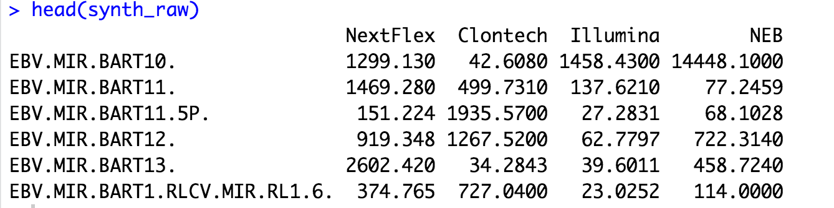
Accuracy Test Method
my_scale <- function(x) { (x - colMeans(x))/ colSds(x) }
error_synth <- data.frame(abs(my_scale(synth_raw)))

Slide 9
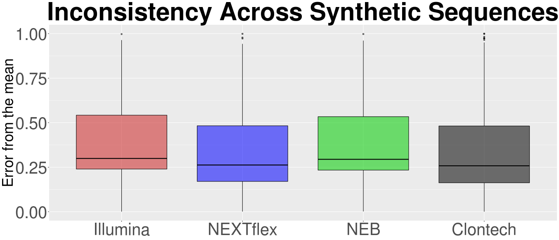
Accuracy Test Results
Error of Synthetic miRNA Detection Across Kits
ANOVA analysis demonstrates that the effect of kit on calculated error is significant (p = 5.26 x 10-6). All pairs of kits were found to be significantly different from each other using pairwise t-tests and Bonferroni correction, except for the pair of NEB and Illumina and the pair of NEXTflex and Clontech.
NEXTflex and Clontech seem to outperform Illumina and NEB for accuracy

Slide 10
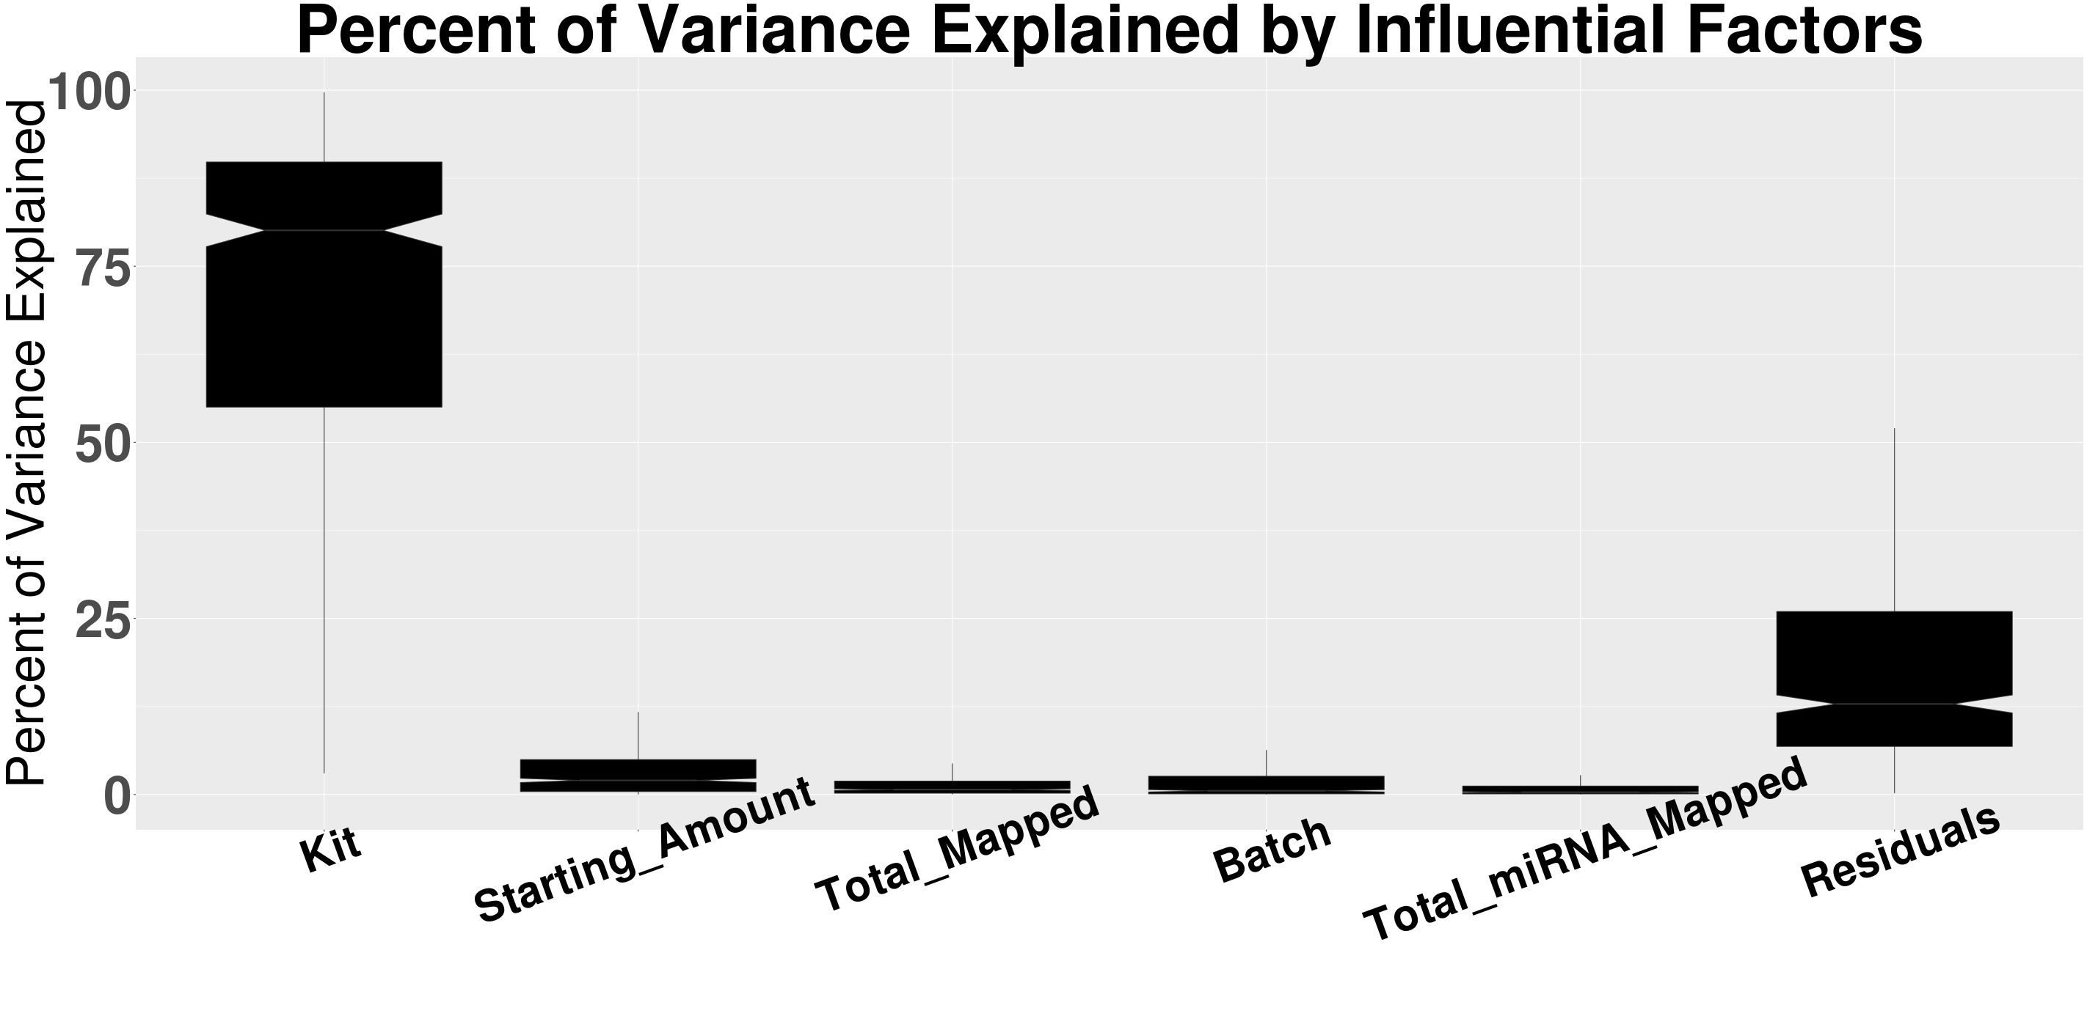
Reproducibility Test Results
The library kit accounts for most of the variance in the data

Slide 11
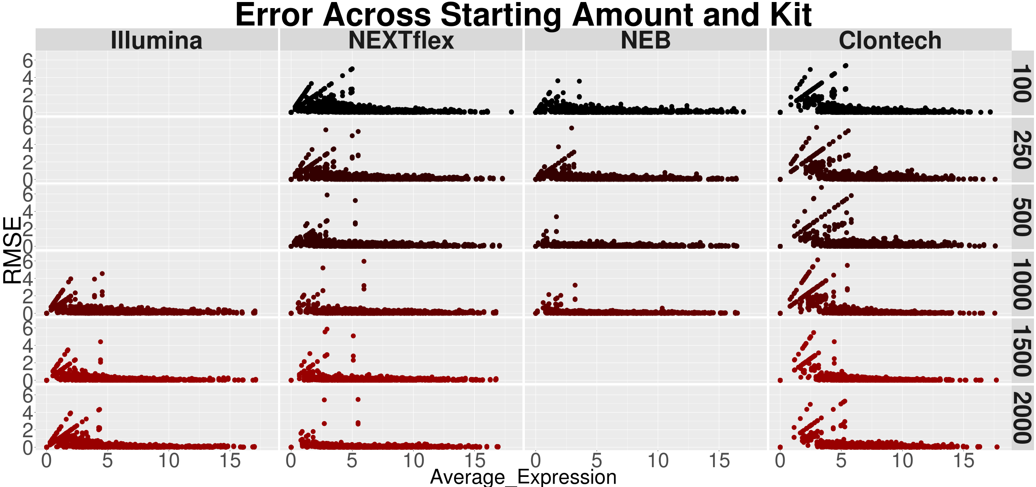
Reproducibility Test Results
Variance
For each kit, increased amount of input reduced the error of moderately expressed miRNAs. The x-axis shows mean log2(RPM+1) expression values for individual miRNAs. The y-axis shows variance across triplicates for each kit at various starting amounts.
For each kit, increased amount of input reduced the error of moderately expressed miRNAs. The x-axis shows mean log2(RPM+1) expression values for individual miRNAs. The y-axis shows variance across triplicates for each kit at various starting amounts.
For each kit, increased amount of input reduced the error of moderately expressed miRNAs. The x-axis shows mean log2(RPM+1) expression values for individual miRNAs. The y-axis shows variance across triplicates for each kit at various starting amounts.
For each kit, increased amount of input reduced the error of moderately expressed miRNAs. The x-axis shows mean log2(RPM+1) expression values for individual miRNAs. The y-axis shows variance across triplicates for each kit at various starting amounts.

Slide 12
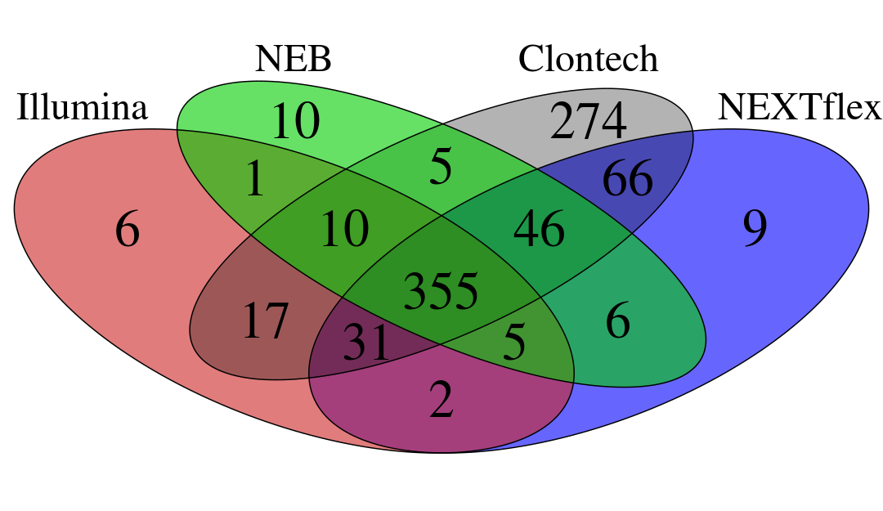
Intersection of Detected miRNAs
Reproducibility Test Method
Kit | Total miRNA >10 RPM
Illumina | 427
NEB | 438
Clontech | 804
NEXTflex | 520
RPM>10 for each kit individually

Slide 13
Reproducibility Test Method
Voom on RPM (reads per million) data of the 355 miRNAs of the intersection
Model for the interaction between library prep kit and batch -How do results vary between batches in different kits?
mod = model.matrix(~pheno_all$Kit*pheno_all$Batch)
Use lmFit and eBayes to get miRNA level stats
Evaluate contrasts for kit + batch interaction effect to get individual p values for each miRNA
Paired ttests on abs(-log10(q values)) for batch interaction effect

Slide 14
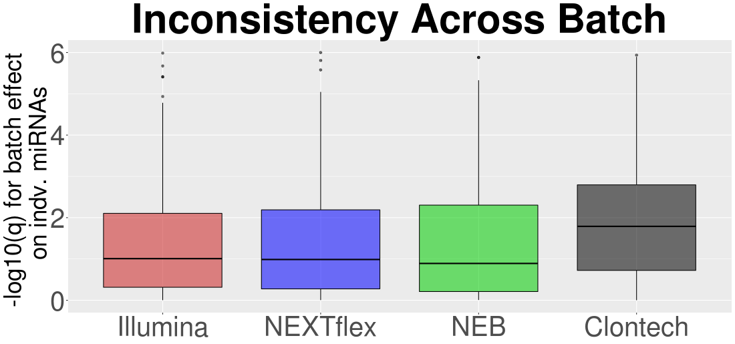
Reproducibility Test Results
ANOVA analysis demonstrates that the effect of kit on batch effect is significant (p = 5.56 x 10-14). All pairs of kits were found to be significantly different from each other using pairwise t-tests and Bonferroni correction, except for the pairs including NEXTflex and Illumina, NEXTflex and NEB, and Illumina and NEB.
Clontech seems to perform more poorly for consistency across batches

Slide 15
Pairwise Analysis of Remaining Highly Expressed miRNA
Illumina and NEXTflex

Slide 16
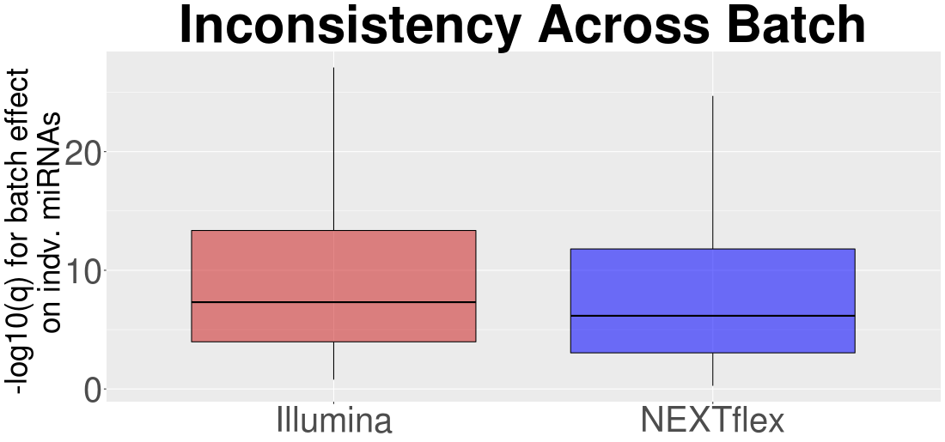
Reproducibility Test Results
Illumina and NEXTflex
p-value = 0.02433, n= 38

Slide 17
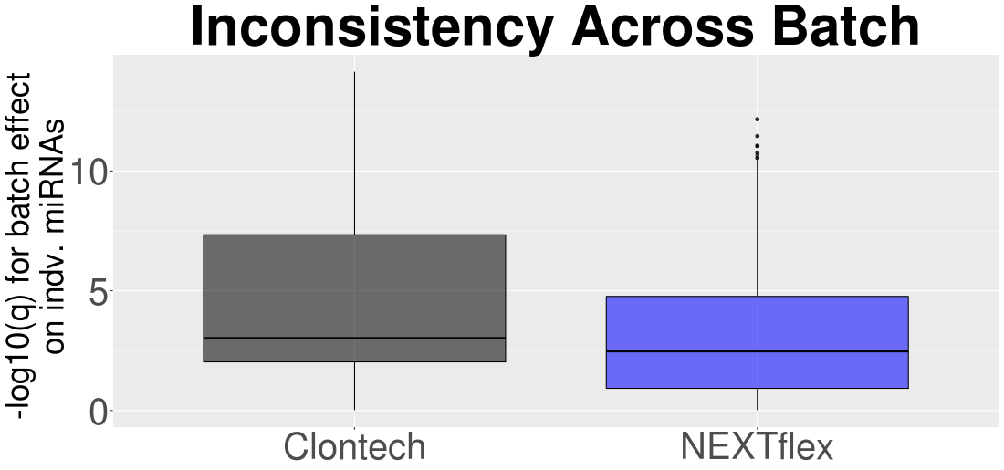
Reproducibility Test Results
Clontech and NEXTflex
p-value = 1.396e-12, n = 143

Slide 18
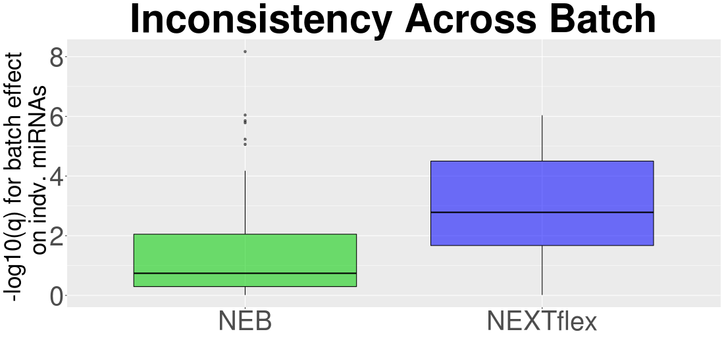
Reproducibility Test Results
NEB and NEXTflex
p-value = 1.382e-06 , n = 57

Slide 19
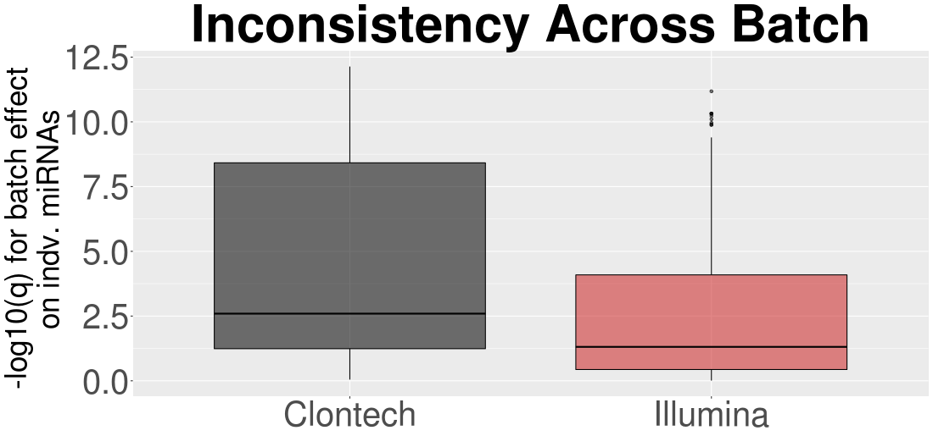
Reproducibility Test Results
Clontech and Illumina
p-value = 2.13e-06, n = 58

Slide 20
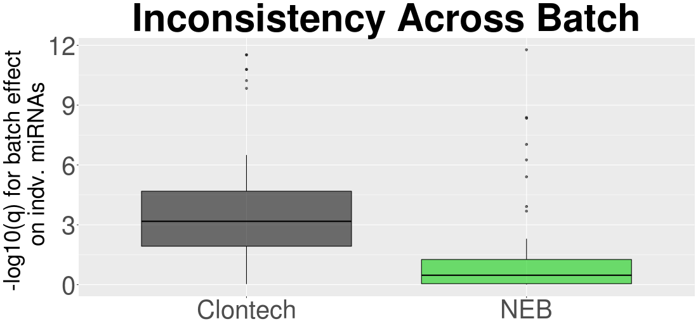
Reproducibility Test Results
Clontech and NEB
p-value = 1.477e-11, n = 61

Slide 21
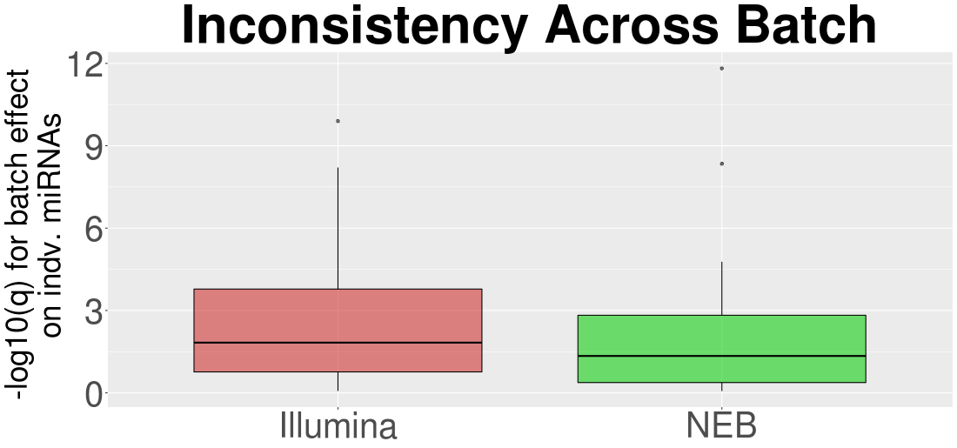
Reproducibility Test Results
Illumina and NEB
p-value = 0.5509, n =16

Slide 22
Summary of Results
NEXTflex, Clontech, and NEB allow for smaller starting input amounts
Clontech and NEXTflex capture various miRNA expression levels more accurately than NEB and Illumina
Accuracy Test Results
Reproducibility Test Results
Clontech performs poorly for reproducibility across batches
NEXTflex, Illumina, and NEB perform quite similarly

Slide 23
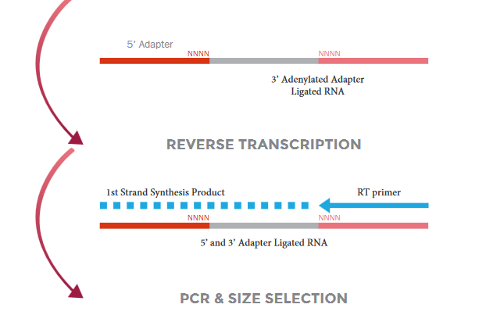
NEXTflex Additional Benefit - UMI
ADAPTER LIGATION

Slide 24
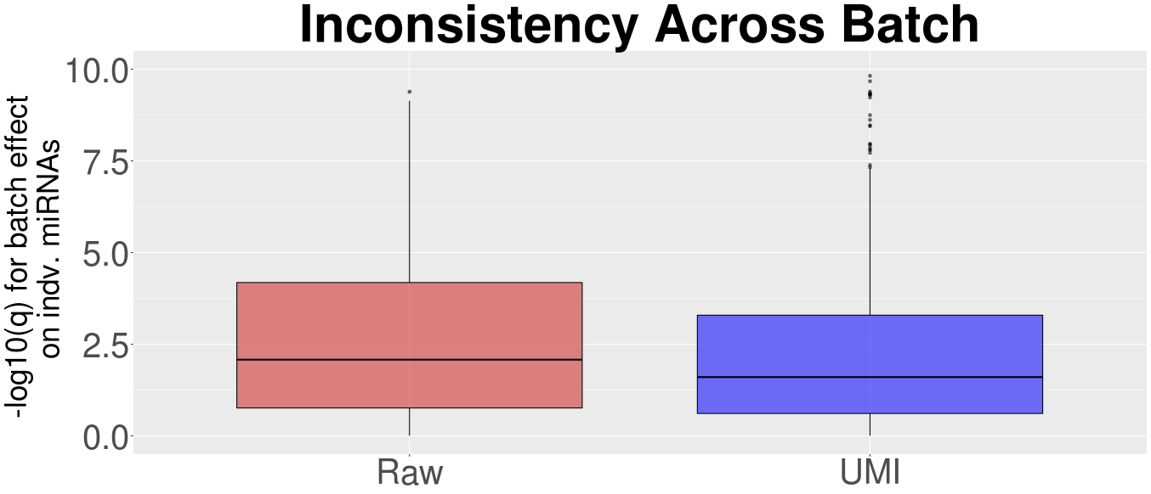
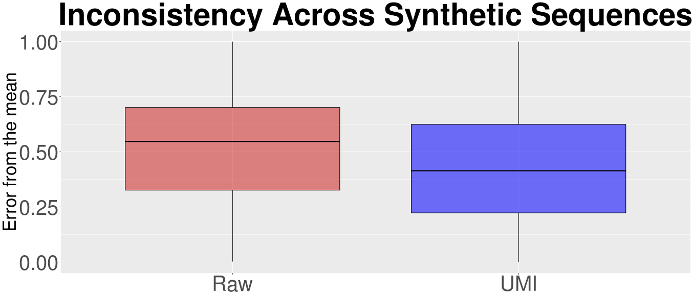
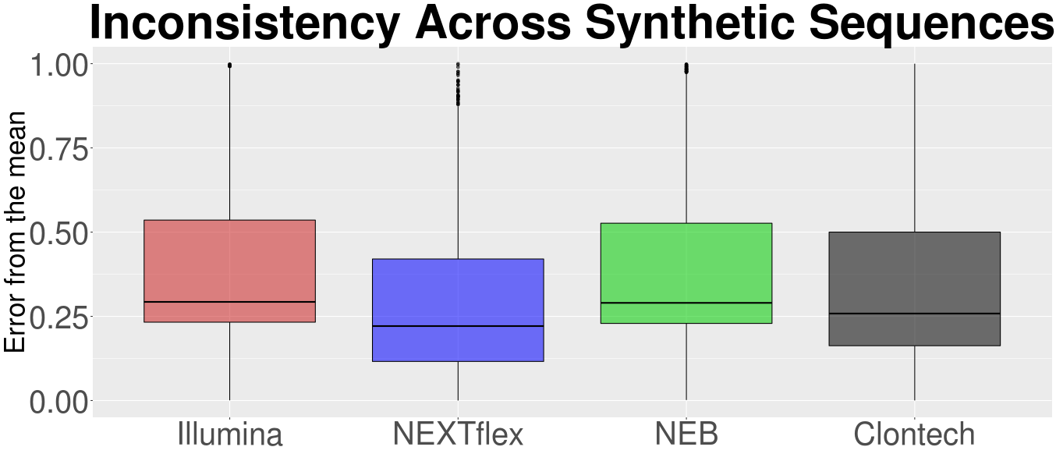
NEXTflex Additional Benefit - UMI
p-value = 9.814e-05
p-value <2.2e-16
ttest between Clontech NEXTflex p-value =3.4e-08

Slide 25
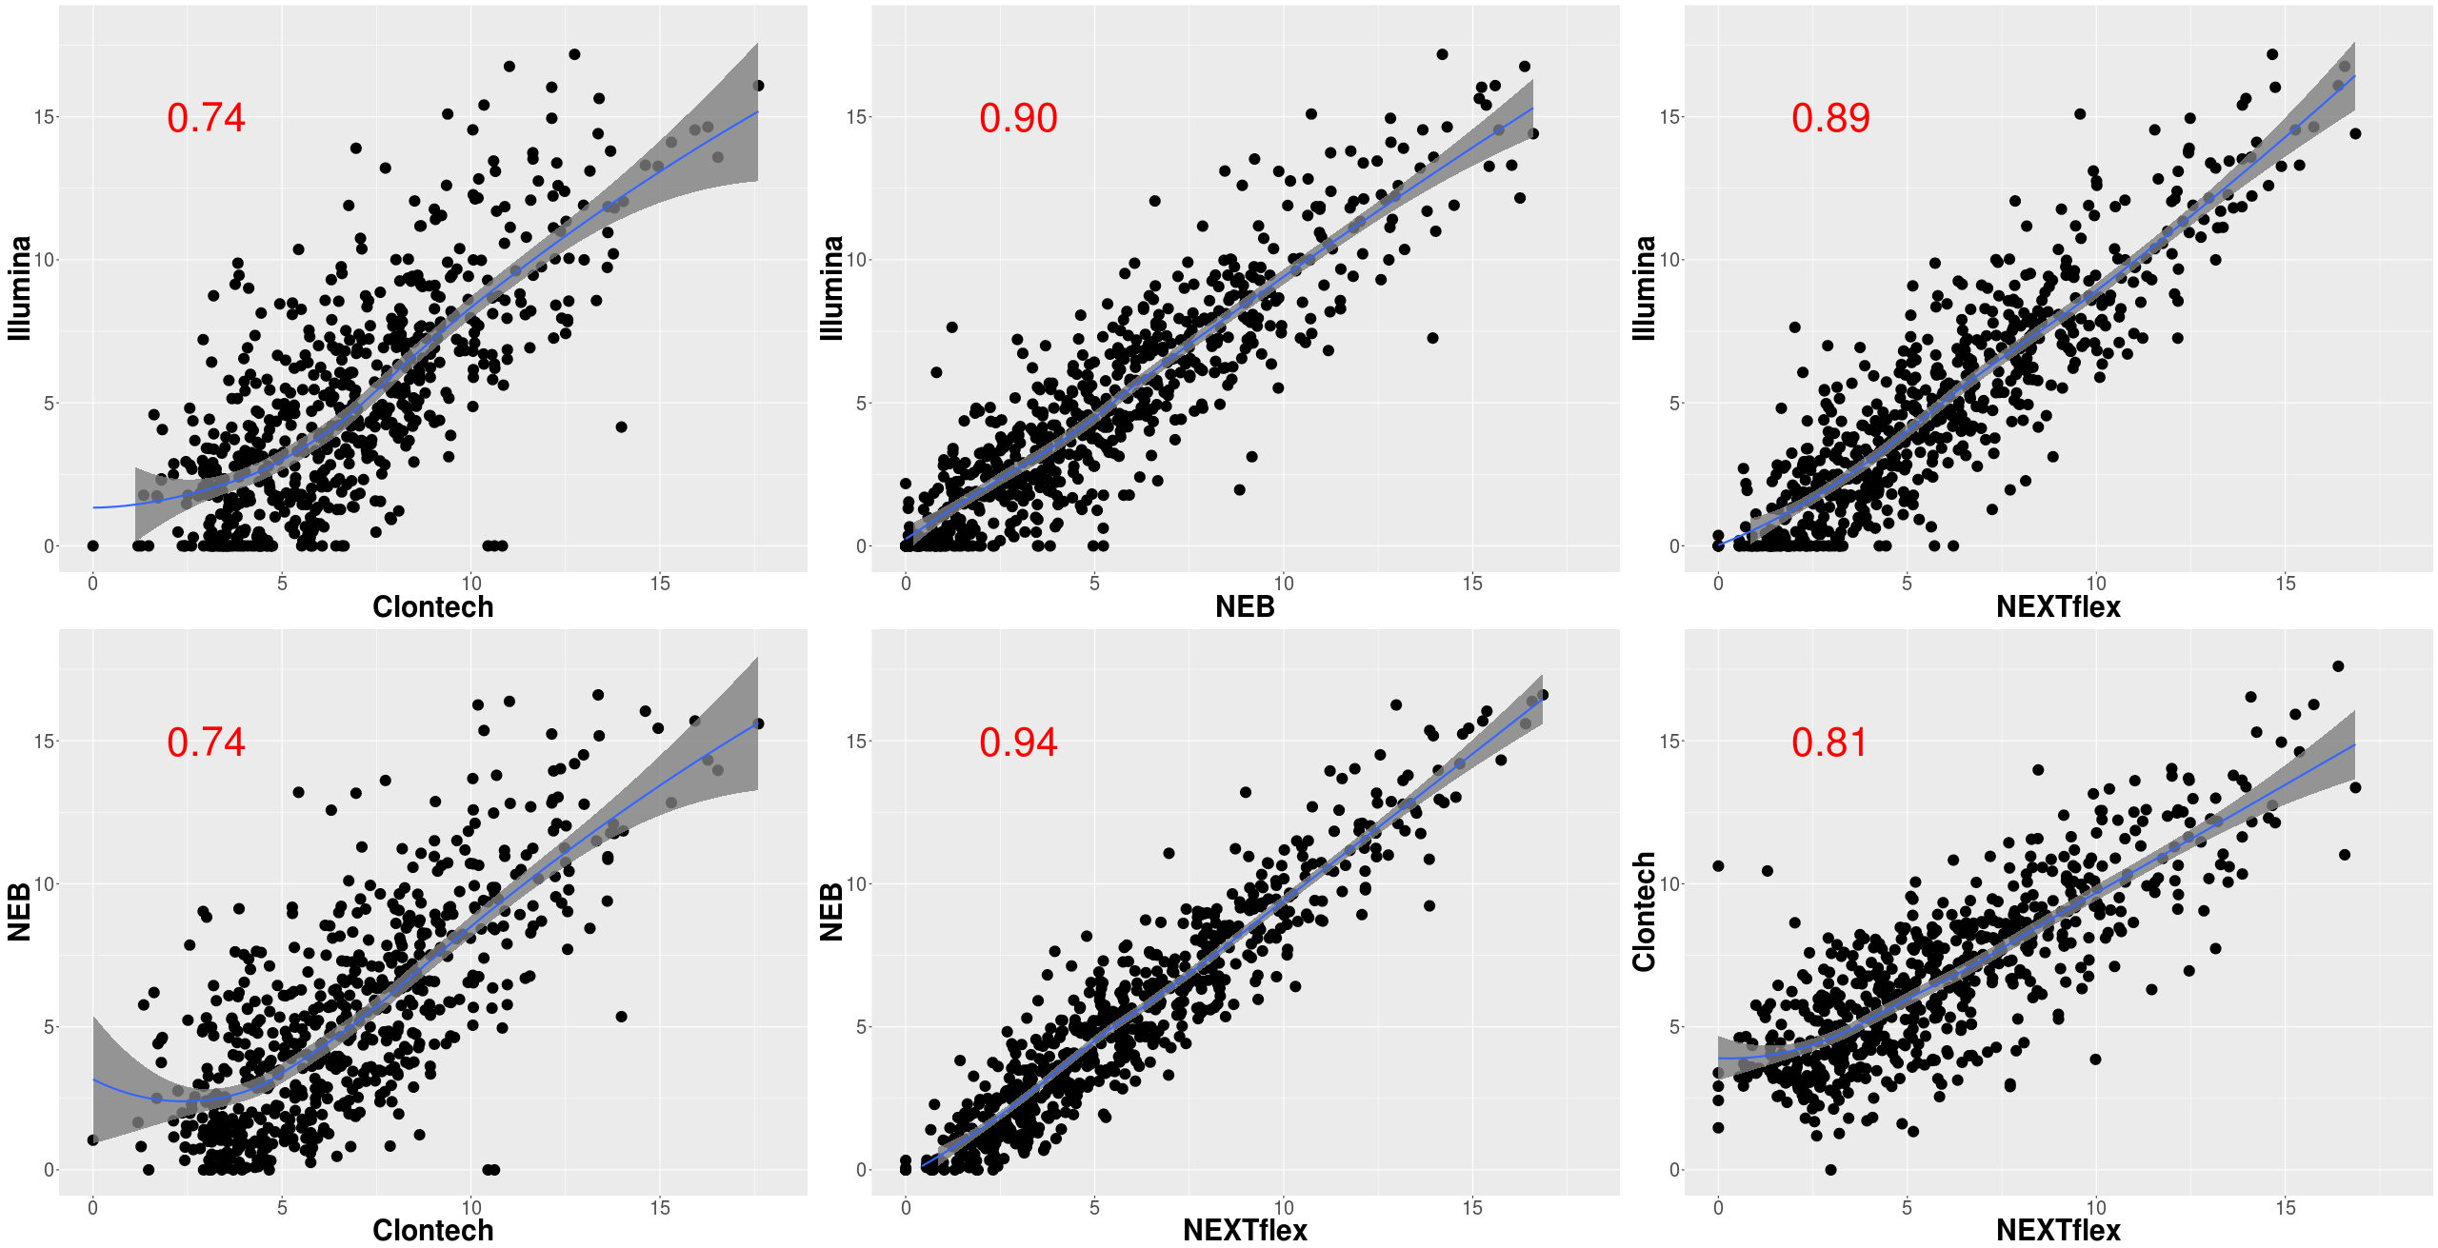
How Similar Are The Results Across Kits?
Illumina, NEB, and NEXTflex are fairly similar, Clontech yields more unique results

